Slide 1
Image Processing Pipeline assignment
Scenario: Build a serverless image processing pipeline using Azure Functions
Challenge: Chain together Functions to process images, each depending on output from another.
Get familiar with Azure Functions and how they can be triggered to do work and output results. The results will appear on your website as they are created.

Slide 2
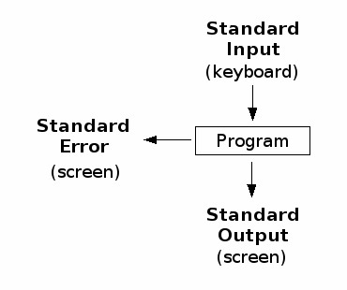
Programming model – Linux
Source: http://labor-liber.org/en/gnu-linux/introduction/index.php?diapo=input_output
Notes:
Key points:
Each program has one job
Single responsibility
Can easily be piped together to form a complex workflow

Slide 3

Programming model – Azure Functions
Blobs
BlobTrigger
(Stream myBlob)
Tracing
(TraceWriter log)
ICloudBlob
(Cloudblob blob)
Notes:
Key points:
Just the same as with the Linux programming model
Single responsibilty
Can be piped together when an output from one triggers and provides input to another

Slide 4


Global Azure Bootcamp 2018 Image Pipeline assignment
Components and data flow
1. Input
3. Input
5. Input
6. Output
2. Output
4. Output
Polling
Azure Function
App Service
Blob Storage

Slide 5
Global Azure Bootcamp 2018 Image Pipeline assignment - final solution example
Components and data flow
ColorMatrixLarge
imagepipeline-scaled-lg
imagepipeline-colormatrix-lg
Ingress
Scaler
ColorMatrixMedium
imagepipeline-originals
imagepipeline-scaled-md
imagepipeline-colormatrix-md
ColorMatrixSmall
Exif
CognitiveServices
imagepipeline-scaled-sm
imagepipeline-colormatrix-sm
Azure Function
App Service
Blob Storage
imagepipeline-exif
imagepipeline-cognitiveservices

